Slide 1
SUPPORT VECTOR MACHINE (SVM)

Slide 3
SVM is a kernel method
Give better classification performance than other ML algorithms on reasonably sized datasets.
They do not work well on extremely large datasets since they involve a data matrix inversion which is very expensive.
It also reformulates the classification problem in such a way that we can tell a good classifier from a bad one, even if they both gave the same results on a particular dataset.

Slide 6
SVM – When data is linearly separable

Slide 7
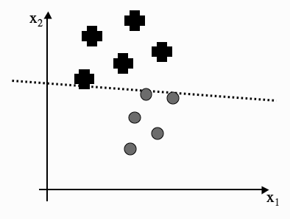
OPTIMAL SEPARATION
Figure 8.1 Three different classification lines. Is there any reason why one is better than the others?

Slide 8
All three of the lines that are drawn separate out the two classes,
so in some sense they are ‘correct’, and
the Perceptron would stop its training if it reached any one of them.
we prefer a line that runs through the middle of the separation between the datapoints from the two classes,
staying approximately equidistant from the data in both classes.
If we pick the lines shown in the left or right graphs of Figure 8.1,
then there is a chance that a datapoint from one class will be on the wrong side of the line,
just because we have put the line tight up against some of the datapoints we have seen in the training set.

Slide 9
The Margin and Support Vectors
FIGURE 8.2 The margin is the largest region we can put that separates the classes without there being any points inside, where the box is made from two lines that are parallel to the decision boundary.

Slide 10
The classifier in the middle of Figure 8.1 has the largest margin of the three.
It has the imaginative name of the maximum margin (linear) classifier.
The datapoints in each class that lie closest to the classification line are called support vectors.

Slide 11
Using the argument that the best classifier is the one that goes through the middle of no-man’s land, we can now make two arguments:
the margin should be as large as possible, and
the support vectors are the most useful datapoints because they are the ones that we might get wrong.
This leads to an interesting feature of these algorithms:
after training we can throw away all of the data except for the support vectors, and use them for classification

Slide 12
Computing optimal decision boundary from a given set of datapoints
w - weight vector (a vector, not a matrix, since there is only one output)
x - input vector
Output y = w· x+b, with b being the contribution from the bias weight
We use the classifier line by saying that
any x value that gives a positive value for w · x + b is above the line, and so is an example of the ‘+’ class,
any x that gives a negative value is in the ‘o’ class.

Slide 13
Let us include our no-man’s land
If the absolute value is less than our margin M, which would put it inside the grey box
w · x is the inner or scalar product, w · x.
This can also be written as w^{T} x, which means that we can treat the vectors as degenerate matrices and use the normal matrix multiplication rules.
For a given margin value M we can say that any point x
where w^{T} x + b ≥ M is a plus, and
any point where w^{T} x + b ≤ −M is a circle.
The actual separating hyperplane is specified by w^{T} x + b = 0.

Slide 14
support vector - a point x⁺ that lies on the ‘+’ class boundary line, so that w^{T} x⁺ = M
If we want to find the closest point that lies on the boundary line for the ‘o’ class, then we travel perpendicular to the ‘+’ boundary line until we hit the ‘o’ boundary line.
The point that we hit is the closest point, and we’ll call it x⁻
the distance travelled to get to the separating hyperplane is M
from x+ to x- is 2M
to write down the margin size M in terms of w
w is perpendicular to the classifier line, the ‘+’ and ‘o’ boundary lines
so the direction travelled from x+ to x- is along w.
to make w a unit vector w/||w||, and so we see that the margin is 1/||w||

Slide 15
making M as large as possible is the same as making w^{T}w as small as possible
we need to try to satisfy two problems simultaneously:
find a decision boundary that classifies well, while also
making w^{T}w as small as possible.
Mathematically, we can write these requirements as:
minimise
(where the half is there for convenience as in so many other cases) subject to some constraint that says that the data are well matched.

Slide 16
Example – 1: Linear
The SVM architecture

Slide 17
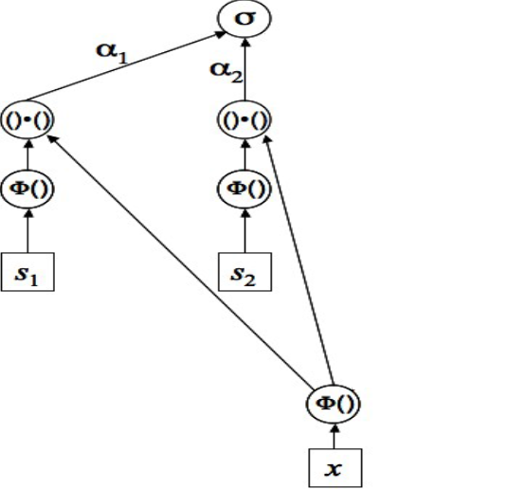
Example – 2:Non-linear

Slide 19
A Constrained Optimisation Problem
A convex problem is one where if we take any two points on the line and join them with a straight line, then every point on the line will above the curve.
If targets +1 or -1,
quadratic programming, takes advantage of the fact that the problem we have described is quadratic and therefore convex, and has linear constraints.
A function is convex if every straight line that links two points on the curve does not intersect the curve anywhere else. The function on the left is convex, but the
one on the right is not, as the dashed line shows.

Slide 20
When we find that optimal solution, the Karush–Kuhn–Tucker (KKT) conditions will be satisfied.
These are (for all values of i from 1 to n, and where the denotes the optimal value of each parameter):
where the lamdas are positive values known as Lagrange multipliers, which are a standard approach to solving equations with equality constraints.

Slide 21
For the support vectors the constraints are equalities instead of inequalities. We can therefore solve the Lagrangian function

